Slide 1

Women’s experiences of incarceration in Canada: HCV/HIV and IDU
On Point: Making Prison Needle and Syringe Programs Work in Canada
Public Forum, Ryerson University
January 23, 2014
Ruth Elwood Martin, MD, FCFP, MPH
University of British Columbia
Collaborating Centre for Prison Health and Education

Slide 2






  No Conflicts of Interest
Public Health
Agency of Canada

Slide 3

Review demographics of incarcerated women in Canada
Tell some of my story – prison physician x 16 yrs
Share some of the wisdom that I have learned from incarcerated women
Share printed material with you (I prefer not to take it back to YVR!)
Generate questions and dialogue

Slide 4
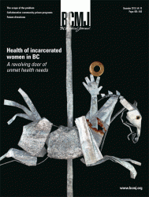
BCMJ December 2012
Guest editorial: The health of incarcerated women in BC
The scope of the problem: The health of incarcerated women in BC
Collaborative community-prison programs for incarcerated women in BC
Future directions for the health of incarcerated women in BC
Notes:
Add screen shot of BCMJ journal

Slide 5
Terminology and numbers
Federal ‘offenders’: sentenced>2 years
Provincial ‘inmates’: sentenced<2 years
Remanded to custody: awaiting sentencing…may be overnight or many months
Canadian custodial admissions 262,067(2010)¹
Notes:
Let me explain the Canadian prison system a little for you.
*Canadians prisoners are either held on a federal sentence (sentenced to 2 years or more),
*or, a provincial sentence (sentenced to less than 2 years)
*or on remand (that is awaiting sentencing: sometimes overnight, but may be months).

Slide 6
Federal Correctional System
53 federal penitentiaries
8,323 federal custodial admissions (2010)¹
  11% female
  27% Aboriginal
15,055 ‘count’-> institution Webpages (2011)
8,016 federal community admissions (2010)
Notes:
In Canada there are
*53 federal penitentiaries,
*housing 12,815 federally sentenced people
*97% are men, 3% are women
And 18-23% are Aboriginal.

Slide 7
Provincial Correctional System
8 adult correctional centres
23,837 BC custodial admissions (2008)¹
  11% women
  25% Aboriginal (4% gen popn)
2100 ‘count’->institution Webpages (2011)
Mean sentence length 45 days
Recidivism 34% returned within 2 yrs of release (2008/9)² ≈ effectiveness
Notes:
In the BC provincial correctional system there are
*8 adult correctional centres
*which house 2,100 people per day
*93% are male, and 7% are women
*There are approximately 30,000 admissions per year
There are also a number of young offender corectional centres, but I don’t have the stats on these.

Slide 8
Substance Use, HIV and HCV
10 Quebec penitentiaries, survey (N=317), (1999)³
  16 % alcohol, 29% drugs, 17% heroin
9 women’s federal facilities, qualitative interviews, (2000/1)⁴
  20/105 (19%) of participants engaging in IDU
CSC, self reported, 2007⁵
  31% HCV men; 37% HCV women
  5% HIV men; 8% HIV women
  22% men IDU; 29% women IDU
Notes:
Substance Use in prisons:
In 1999, a survey in 10 Quebec penitentiaries was conducted with 317 respondents. During their previous three months incarceration,16% reported using alcohol, 29% reported using some psychoactive drug, and 17% reported using heroin.
In 2000/1 DiCenso and her group conducted open-ended qualitative interviews with women, 9 federal facilities. 19% of study participants reported that they were currently engaging in Injection drug use.
Studies from prisons in other countries, published in the worldwide medical literature, report similar findings….. incarcerating people with substance use disorders does not result in discontinuation of substance use inside prison.

Slide 9
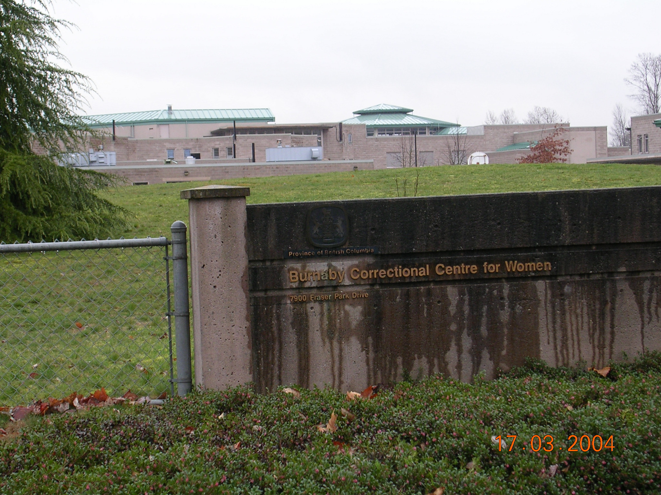
Back in 1994.....
Notes:
Burnaby Correctional Centre for Women (BCCW).
May I ask you how many of you have worked or visited inside a prison? Thank you, that’s helpful. Let me tell you my story of how I started to work in a prison, and why I find prison medicine interesting, rewarding and challenging. If you were to meet other prison physicians and nurses, they will probably tell you similar stories, or maybe you have similar stories to tell yourself.
In 1994, a friend mentioned to me that women’s provincial correctional centre for women desperately needed a physician to work there once a week and would I consider it? At that time, I was juggling a full-time private family practice and 4 small children, but I had been thinking about making a career change because I was reflecting on the things I did not enjoy about private practice (namely running a small business) and the things that I loved (namely, practicing medicine). When I heard about this prison position my immediate reaction was no way, that type of work must be for only the type of physician who can’t find work elsewhere, the lowest of the low. But, I found the possibility intriguing and finally decided that I had nothing to loose by trying it out. The first day I spent in the prison clinic, I saw more women with disease and poor health than I would ever see in a month of working in family practice in my clinic on the west side of Vancouver. I saw numerous women with HIV and hepatitis C, pregnant women who had not received prenatal care before coming to prison, pre-cancerous lesions of the cervix, bacterial endocarditis, sexually transmitted infections. As I listened to women’s medical histories, I would also listen to their childhood stories of abuse and trauma, their substance use, their poverty and homelessness, their attempts to become healthy and to turn their lives around. I knew from the day of my first prison clinic, that prison medicine was something that I could and would not leave.

Slide 10

Cervical Cancer Screening
Martin RE. A review of a prison cervical cancer screening program in British Columbia. Can J Public Health. 1998; 89.6: 382 – 386. ⁶
Martin RE. Would female inmates accept Papanicolaou smear screening if it was offered to them during their incarceration? CMAJ. 2000; 162.5: 657 - 658.
Martin RE. Is it feasible for women to perform their own Pap smears? A research question in progress. CMAJ. 2000; 162.5: 666 - 667.
Martin RE, Hislop GT, Grams GD, Calam B, Jones E, Moravan V. Evaluation of a cervical cancer screening intervention for prison inmates. Can J Public Health. 2003; 95.4: 285 - 289.
Martin RE, Hislop GT, Grams GD, Moravan V and Calam B. Beware of multiple names in database linkage research: prevalence of aliases in female prison population. BMJ. 2005; 331.7512: 335 – 336.
Martin RE, Hislop GT, Grams GD, Moravan V, Calam B. Three-year follow-up following a prison-based cervical cancer screening intervention pilot program. Can J Public Health. 2008; 99.4: 263-266. ⁷
Notes:
Relevance to women? Priority for them? Made any difference for the under-screened women?

Slide 11

Fiona Gold and Wendy Murphy, Aids Prevention Street Nurse Program, BCCDC (2001)
Sixty-one item cross-sectional questionnaire was developed, voluntary, self-administered.
Nurses held info sessions for women; they completed questionnaire during lock-down times.
UBC Research Ethics Board Certificate of Approval
Research Agreement with BC Ministry of AG. # 00/01-12
Women surveyed (N=104, 83% response rate)⁸
21% women reported IDU while incarcerated
Notes:
In 2001, a survey conducted by Fiona Gold and Wendy Murphy at BCCW, found similar findings to DiCenso’s study. (104 women responded, giving an 83% response rate. 21% of women reported injection drug use at some point in time inside prison.)

Slide 12
Prevalence of reported SDU and IDU outside and inside BCCW (n=104)

Slide 13
Self-reported infectious disease status of women in BCCW
IDU reported in BCCW (n=22)
IDU not reported in BCCW (n=82)

Slide 14
Infectious disease transmission: reported risk factors in BCCW IDUs (n=22)
82 % re-use own needles
82 % share own used needles
77 % share others’ used needles
90 % clean needles with bleach

Slide 15

Dr Dayna Mudie, family practice resident (2001)
Six IDU women (heroin); ages 26-46; 4 Caucasian & 2 Aboriginal.
Education range: grade 5 to grade 11.
5 self-identified HCV + positive; All 6 as HIV negative.
2 on the methadone program in prison.
All women had multiple incarcerations (range 4-30); current sentence lengths from 3 to 12 months.
Face to face interviews, audio-recorded, transcribed.
Transcripts were analyzed word-by-word and sentence-by-sentence to identify and code all ideas; organized into major concepts; common themes identified; illustrative quotes selected.
Certificate of Approval – UBC REB. #B00-0587
Research Agreement with BC Ministry of AG. # 00/01-09⁹

Slide 16
Findings
Three overall themes emerged from the data:
Controlled by heroin: overwhelming control over their women’s lives resulting in a cycle of drug use, crime and incarceration – outside and inside prison.
The resolve to change: for some women, once off drugs (inside prison), their resolve to change was strong -> incarceration can be an opportunity.
Resources are needed by incarcerated women to use their incarceration to best advantage (e.g. access to gender-sensitive healthcare, harm reduction programs, trauma-informed counseling and discharge planning) - but resources are often lacking.

Slide 17
Controlled by Heroin on the outside
“My entire record is drug-related: prostitution, possession, trafficking, thefts under, thefts over, B+E’s….My choice is either to sell dope or sell myself. When I get tired of prostitution, tired of getting beaten up, I’d sell dope. When I got tired of that, when I need more money, I’d go back to working the streets. I had to do crime all the time to pay for my next fix but I wasn’t even getting high anymore.”

Slide 18
Controlled by Heroin inside prison
“Everybody shares needles in here. There’s just not enough of them. A couple of times I was able to smuggle new needles in here and sell them. I’d come back 3 or 4 months later and they’d have the same ones. They’d use them until they were mangled. Sometimes they would bleach them before they shared them but most of the time they didn’t even do that.”
Notes:
READ

Slide 19
Controlled by Heroin inside prison
“There was one girl who was sick in bed for three days, withdrawing off the methadone because others were making her give it to them. There’s a lot of pressure on people to regurgitate it for others. Once they’ve done it once that’s it, they’re obligated. Others do it to sell it. People think they can put it in the microwave, heat it up and kill whatever’s in it.”

Slide 20
The Resolve to Change
“Coming to jail this time saved my life. I would have OD’d if I hadn’t come in. Now I’m off the drugs and I want to keep it that way. The real battle is being here long enough to totally dry out. Now that I’m off I don’t want to use again. I want to get my life back. I’m tired of spending all my time arranging my next fix.”

Slide 21
Lack of Resources
“There’s no ongoing drug program here. Occasional NA meetings but nothing regular. There’s nothing to rehabilitate women here and nothing to help them stay off the drugs when they get out. They just send you out. You don’t have any release plans. In the past I’ve just gone right back to Main and Hastings and started using again. It’s the only place I know. A lot of women have no choice but to go back to drugs and crime as soon as they get out.”

Slide 22
Then what? …the KT
Presentation to prison management staff
Report to Corrections Branch, Ministry of AG
Conference presentations
Academic publication
BC Attorney General, radio interview, “we don’t have drugs in our prisons”

Slide 23
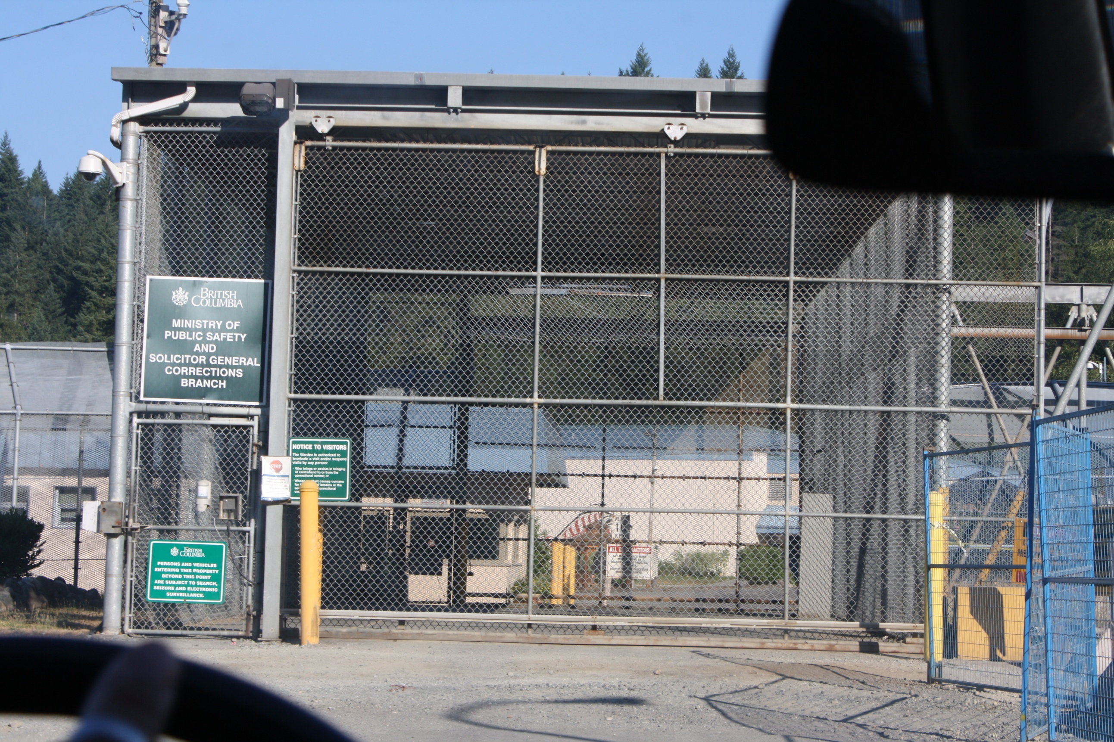
Notes:
Alouette Correctional Centre for Women

Slide 24
Publisher:
Inanna Publications
(June 30, 2014)
https://www.inanna.ca/catalog/arresting-hope-women-taking-action-prison-health-inside-out/
Net proceeds will be used to provide educational bursaries for women with incarceration experience and/or their families.
Notes:
Read from the flyer
Why the book? Like in a your kids in school – change in principal – change in ethos
Prison physican – observing the changes (10 wardens? 10 health care managers)
It needed to be written!! 2004-2008 – therapeutic place for women – because of the leadership qualitaties of the warden. If there have been a winning court action on prison syringe exchange programs, Brenda Tole would have been the first to introduce this prison might have been the first to introduce on e in Canada.

Slide 25
‘Arresting Hope’ portrays hope for ways to implement a prison program…..
Arrival in Prison: A Warden’s Vision
Daily Life in Prison
Recreation Therapy in Prison
Babies in Prison
Participatory Health Research in Prison
Community in Prison
Indigenous Learning in Prison
Stories of Transformation in Prison

Slide 26



Thank you for listening!
Please take some CCPHE our project briefs – preventive health and cancer screening
Collaborating Centre for Prison Health and Education
Email: prison.research@familymed.ubc.ca
Phone: 604-827-4976
CCPHE banners paintings: Artist Mo Korchinski lives in Maple Ridge, BC, and is a mother and grandmother. Mo paints with acrylics on canvas to portray images that inspired her during her incarceration and during her (re)integration into the community. Mo is also community-based researcher with Women in2 Healing and is passionate about working to improve the health and education of women inside and outside of prison.
@ccpheUBC
www.facebook.com/CCPHE.UBC

Slide 27
References
¹ Canada Statistics. Correctional Services. Adult correctional services, admissions to provincial, territorial and federal programs . [Internet]. Available from: http://www.statcan.gc.ca/tables-tableaux/sum-som/l01/cst01/legal30b-eng.htm Dostoevsky, Fyodor. The House of the Dead (1862)
²Ministry of Public Safety and Solicitor General, 2010/11 – 2012/13 SERVICE PLAN , March 2010
³Poulin C, Michel A, Gilles L, Gaston G, et al. Prevalence of HIV and hepatitis C virus infections among inmates of Quebec provincial prisons. CMAJ .2007;177(3): 252-256.DOI: 10.1503/cmaj.060760
⁴DiCenso AM, Dias G, Gahagan J. Unlocking our Futures: A National Study on Women, Prisons, HIV, and Hepatitis C. 2003. Prisoners' HIV/AIDS Support Action Network (PASAN). http://www.pasan.org/Publications/Unlocking_Our_Futures.pdf
⁵Calzavara L, Ramuscak N, Burchell AN, et al.Prevalence of HIV and hepatitis C virus infections among inmates of Ontario remand facilities. CMAJ.2007; 177.3: 257
⁶Martin RE. A review of a prison cervical cancer screening program in British Columbia. Can J Public Health. 1998; 89.6: 382 - 386.
⁷Martin RE, Hislop GT, Grams GD, Calam B, Jones E, Moravan V. Evaluation of a cervical cancer screening intervention for prison inmates. Can J Public Health. 2003; 95.4: 285 - 289
⁸ Martin RE, Gold F, Murphy W, Remple V, Berkowitz J, Money D. Drug use and risk of bloodborne infections: a survey of female prisoners in British Columbia. Can J Public Health. 2005; 96.2: 97 – 101.
⁹ Mudie D, Martin RE, Grams GD. Female Inmates and their Experiences with Injection Drug Use. Fifth Western Departments of Family Medicine Research Conference. Vancouver. May 2005

