Slide 1
In prison drugs do not enter!
that's what the authorities mostly say…
Daniela De Santis
Prevention coordinator
Switzerland
January 2014

Slide 2
Insiders know better..
Drug addicts have already gone to considerable illegal lengths to get their drugs.
And we can not stop them entirely even in the prison setting.

Slide 3
It is known worldwide; if drug addicts are incarcerated, drugs enter in prison and these are also injected!
This means:
A few syringes are in prison
Syringes are shared
Diseases as HIV, HCV and HBV are transmitted
Abscesses occur often
There are sometimes fatal overdoses
Hidden syringes may be a danger to the staff

Slide 4

In the enclosed setting of a penitentiary, infectious diseases such as AIDS or Hepatitis are easily spread by the exchange of used syringes and by sexual contact without protection.

Slide 5
Syringe exchange in the prison setting
The feasibility of needle exchange in the prison setting, as shown by the example of Hindelbank prison in Switzerland.

Slide 6
Hindelbank was the first prison worldwide
to introduce in 1994 syringe exchange program to inmates.

Slide 7
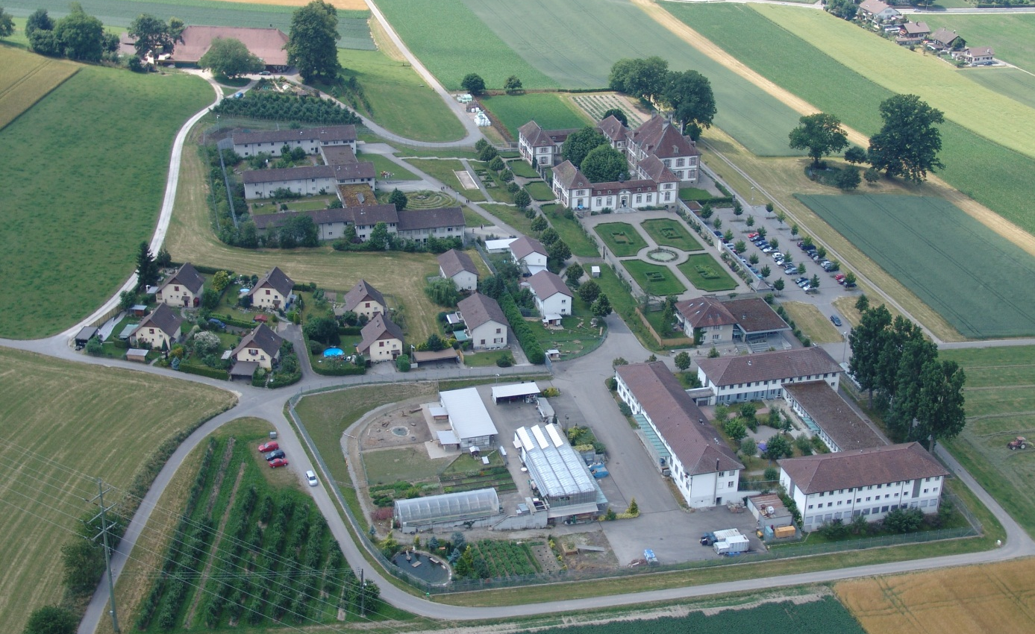
Hindelbank Prison is located 20 km north of Bern
It is a penitentiary for women, which is able to house 110 prisoners in six divisions and includes staff of approximately 100.
It is the only prison for woman in the German part of Switzerland.

Slide 8
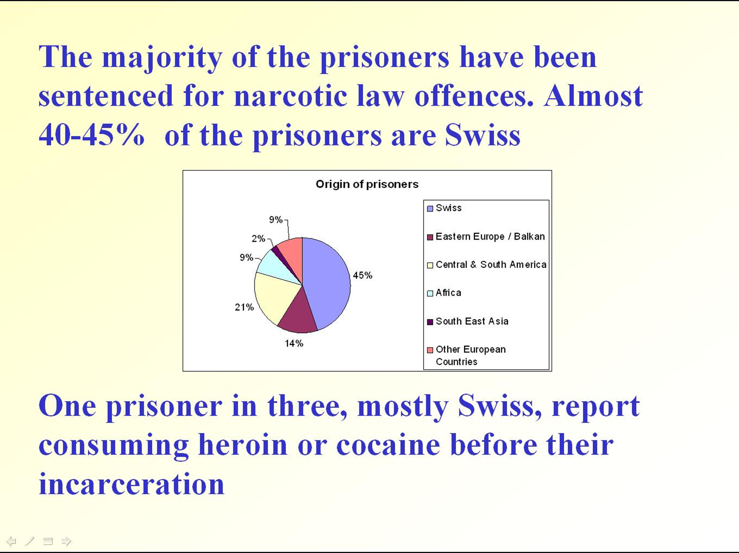

Slide 9
Length of sentence

Slide 10
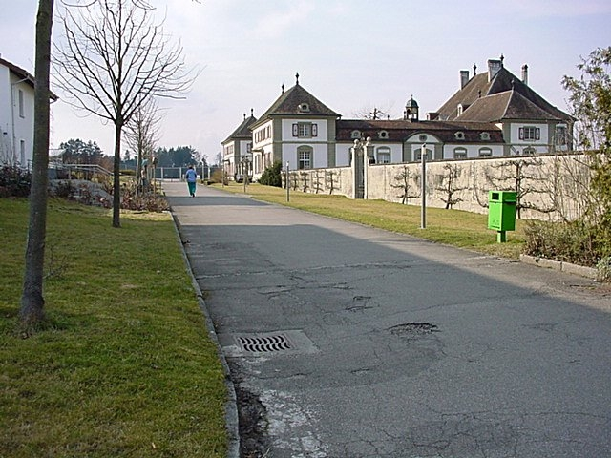
The Hindelbank prison has been confronted with the problem of clandestine drug consumption for many years.
First time in 1987 was mentioned in the prison’s annual report about the exchange of used syringes between prisoners.
In 1991, an informal poll carried out by the
penitentiary physician revealed alarming statistics about needle-sharing and transmission of infectious diseases.

Slide 11
It took four years of legal and
political clarification before the pilot
project was realised in July 1994 with the
financial support of the Swiss Federal Office of Public Health.
The prevention program was aimed at all prisoners and, as far as suitable, at the relevant prison staff.

Slide 12

Drug Consumption
The pilot project started with training for the relevant staff focused on
topics as Drug addiction, Hepatitis and HIV- infections, corresponding protection measures and
assistance in emergency cases involving drugs
According to data gathered from the prisoners, both legal and illegal drugs- ranging from tobacco, alcohol and cannabis to tranquillizers, painkiller and sedatives, to heroin and cocaine are more or less frequently consumed at Hindelbank prison.
And the prevention program was aimed at all prisoners. Included meetings, discussion and role plays. The Program was offered in German, French, English and Spanish

Slide 13
The primary goal of the prevention program at Hindelbank prison includes, in particular, the syringe exchange, to achieve inmate abstinence from drug use.
Our secondary goal is the harm reduction.

Slide 14
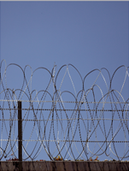
We are trying to achieve the abstinence through two strategies:
First goal repression:
Prisoners control
Cell control
Urine testing
Control of all incoming post and packages
If we find something irregular, it will leads to sanctions.

Slide 15
Secondary goal:
Harm reduction
Through syringe exchange, regular counseling and accompaniment by the prevention coordinator.

Slide 16
I meet personally with every new inmate upon entry to the prison.
Inmates are provided with information such as HIV; HCV; HBV and other STD’S.
Review of their history of drug use.
If there exists a drug-history prior entry in Prison.
If they have had so, provide them with all the information about syringe exchange program.

Slide 17
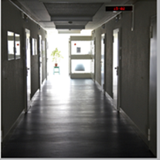
The drug injecting addicts get, if so desired, a maximum of one complete syringe with filter, five additional needles, sterile swabs, one spoon in a transparent box.
The syringe and needles must be kept in this box. Therefore the syringe are immediately identified be the staff entering in the cells or on cell checks.
Used syringes can be exchanged at the distributing machines located in any section of the prison in relatively private areas. Like cupboards in recreational areas and storage areas for cleaning equipment for inmates.

Slide 18
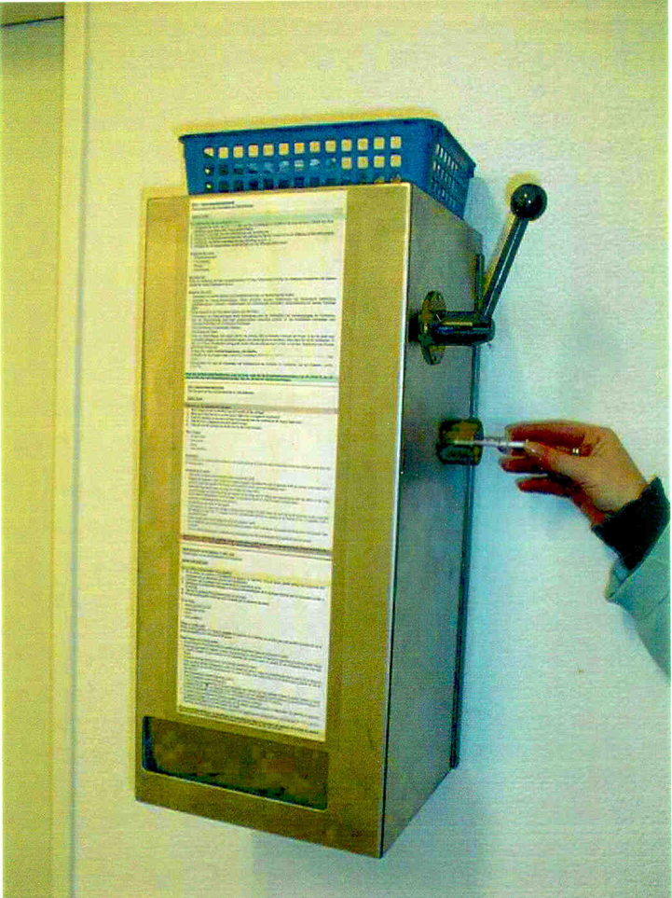
Number of distributed Syringe over the years.
1995/6 5’335
1997 1’129
1998 1’236
1999 1’080
2000 435
2001 357
2002 198
2003 305
2004 340
2005 178
2006-2012 30-120
2013 421

Slide 19
Like the number of syringes distributed, the number of these sanctions increased towards the end of the month as well as before and after installation of the pilot project.
-----------------
This in contrast to sanctions related to other behaviour did not evolve.
Inmates are not sanctioned solely for possessing injecting equipment as long as it is stored in accordance with the rules of the syringe exchange program.

Slide 20

In May of 1994, before installation of the distribution machines, 8 intravenous drug-users of 19 declared to have exchanged syringes with other users.
One year later, there was only one individual who continued this practice, today, after 19 years only two inmates reported use of dirty syringes.

Slide 21
Practical experiences in the past nineteen years
The assumed contradiction, to punish consumption while at the same time distributing clean needles, was subject to numerous discussions, also in Hindelbank.
Today after nineteen years of prevention in Hindelbank, the theme is a normal and accepted part of the day-to-day running of the prison.

Slide 22
The comprehensive and extensive prevention program, implemented in Hindelbank, goes far beyond syringe exchange and includes:
Information of all incoming inmates
Harm reduction events
Regular information evenings
Streetwork

Slide 23
Street work
As the prevention coordinator I visit each section once a week at least.
The fact that my responsabilites are not connected to any other role at the prison, enhances the confidentiality of the contacts with inmates.
It is important to the success of the program, that there is someone with whom the inmates can be absolut honest without the risk of any sanction!

Slide 24
  All these aspects of the extensive prevention programme have proven to be effective in the last nineteen years.
The two external evaluations
(in 95 and 96) have confirmed:

Slide 25

The positive experiences
Increase in drugs abuse was not confirmed.
Sterile needles did not influence the amount of available drugs.
There is no more needle sharing among prisoners.
Much less overdoses.
No prisoner has started to use drugs in the prison setting.
No dirty needles were found in the garden or in the departments.
The occurrence of injection abscesses has decreased enormously.

Slide 26
One of the biggest fears was not confirmed:
Until now, over more then
nineteen years of syringes exchange,
needles have never been used as a weapon!

Slide 27
Conclusion
The amplitude of drugs consumption, the risk behaviour due to drug abuse and sexual relations, as well the prevalence of HIV and Hepatitis-infections in the Hindelbank prison, reflect the existing situation on an international level.

Slide 28
The results of the prevention programme carried out at Hindelbank Prison do not furnish any arguments against the continuation of the distribution of sterile syringes.

Slide 29

The consumption of hard drugs in the prison of Hindelbank remains illegal and leads to sanctions such as the suspension of holiday.
The distribution of sterile needles is purely a health measure and do not allowing consumption.

Slide 30
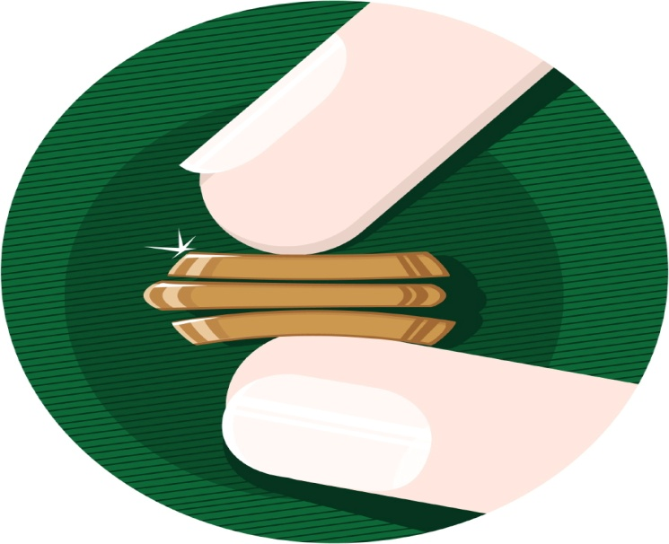
It is a very cost-effective measure:
As measured by the budget of the prison Hindelbank, the cost for the whole prevention measures are 0.3 % . My wage is included!

Slide 31
To prevent HIV and Hepatitis transmission in prison will avoid further infection among injecting drug users, the larger prison population, and ultimately, in the community outside prison.

Slide 32
Thank you for your attention
Daniela De Santis January 2014

